Slide 1


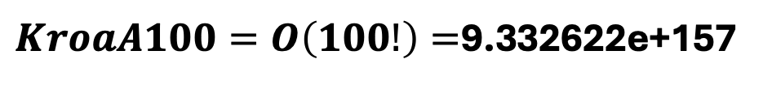
1
Fitness
3 | 4 | 1 | 6 | 2 | 5
4 | 6 | 1 | 3 | 2 | 5
Big O
$$n∗\left(n−1\right)∗\left(n−2\right)∗…∗1$$
3
4
$$O(n!)$$
6
$$O\left(6!\right)=1∗2∗3∗4∗5∗6=720$$
2
5
$KroaA100=O\left(100!\right)=$9.332622e+157

Slide 2
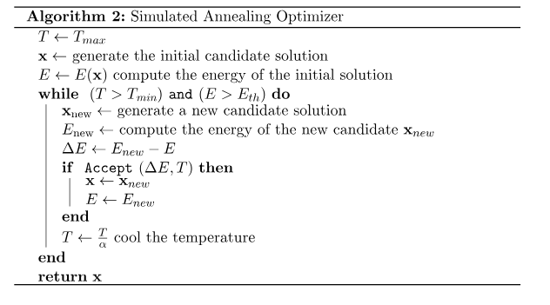
3 | 4 | 1 | 6 | 2 | 5
22400
3 | 4 | 1 | 6 | 2 | 5
3 | 5 | 1 | 6 | 2 | 4

Slide 3
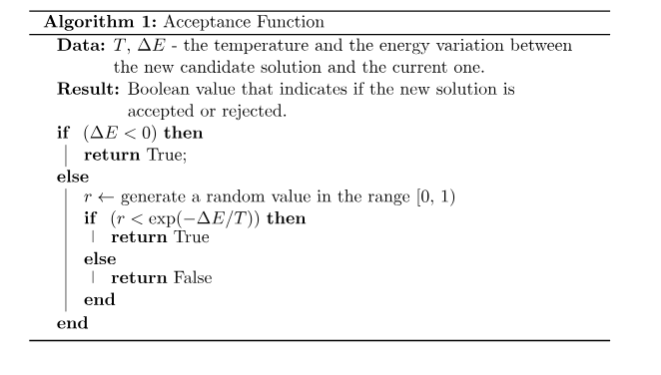


Slide 4
